Slide 1

CONTROLLING COMPUTER USING HAND GESTURES
Final Year Project
Date: 08/09/2021
Students Name:
Shubhangi Kadam (MITU18BTCS0102),
Pradnya Kedari (MITU18BTCS0121),
Rutika Chaudhari (MITU18BTCS0045)
Department of Computer Science Engineering
MIT School of Engineering
MIT Art, Design and Technology University

Slide 2
OUTLINE
INTRODUCTION ( Basics required for understanding the topic )
Existing systems comparison – Market Survey
STATE OF ART - (Literature Survey) ( study of similar research work till date )
RESEARCH GAP ( what are the features that are not worked upon till date that you will address in your work )
OBJECTIVE ( what is your aim while executing the project )
Problem Statement ( in one or two sentences what your project is )
References ( Only ieee, sciencedirect, Elsevier, acm , scopus indexed )

Slide 3
INTRODUCTION
What are gestures?
Hand gesture recognition was achieved with wearable sensors attached directly to the hand with gloves. These sensors detected a physical response according to hand movements or finger bending. The data collected were then processed using a computer connected to the glove with wire. This system of glove-based sensor could be made portable by using a sensor attached to a microcontroller.
Hand gestures for human–computer interaction (HCI) started with the invention of the data glove sensor. It offered simple commands for a computer interface.
Hand gesture recognition is one obvious way to create a useful, highly adaptive interface between machines and their uses.
Hand gesture recognition technology would allow for the operation of complex machines using only a series of finger and hand movements, eliminating the need for physical contact between operator and machine.

Slide 4
Market Survey
The gesture recognition system has emerged as a popular technology over traditional mechanical interaction technologies.
The market is segmented on the basis of Type, Application, Technology, Product and geography.
Assistive robotics
Sign language detection
Immersive gaming technology, smart tv, virtual controllers.
Virtual mouse

Slide 5
Literature survey
Pansare, J. R., et al. "Gestuelle: A system to recognize dynamic hand gestures using hidden Markov model to control windows applications." International Journal of Computer Applications 62.17 (2013).
Premaratne, Prashan. Human computer interaction using hand gestures. Springer Science & Business Media, 2014.
Singh, Sahib, and V. K. Banga. "A Review of Hand Gestures Techniques for PC Applications."

Slide 6
Research gap
In this project we will create our own dataset using opencv modules and python libraries.
Here we are going to use python language and convolutional neural network using keras and tensorflow to train our module.
Train our module to recognize the gestures and match them with datasets.
Then perform the actions like opening the files, scrolling up and down webpages, contolling media player, controlling brightness and volume.

Slide 7
Objectives
Reducing the efforts of interaction with computers using simple hand gestures.
To recognize and interpret movements of the hand in order to interact with and control a computer system.

Slide 8
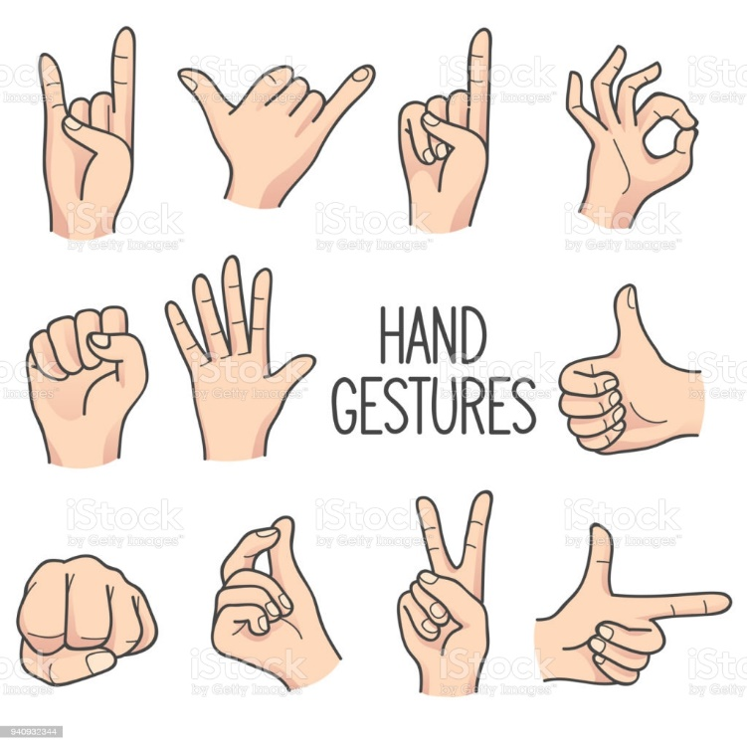
Problem Statement
The aim of this project is to develop an application to enable users to control other their computers by using hand gestures and a webcam.

Slide 9
References
https://www.sciencedirect.com/science/article/pii/S2212017316001389
https://ieeexplore.ieee.org/document/7176405
https://towardsdatascience.com/artificial-neural-networks-for-gesture-recognition-for-beginners-7066b7d771b5
https://techvidvan.com/tutorials/hand-gesture-recognition-tensorflow-opencv/

Slide 10
THANK YOU !

